Slide 1
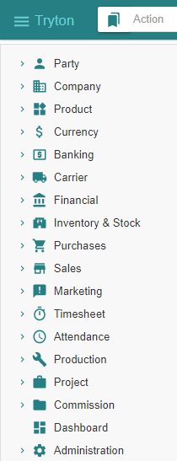
- Getting started - Purchase
Tryton By Example
Github - https://github.com/clixwise/tryton-by-example Version of presentation : 6.0 Version of Tryton : 6.0 Verified for execution on : Windows 10 & Powershell 7 Licence : CC BY 4.0 Author : Marc Rottiers

Slide 2
Table of Contents

Slide 3
TOC
MODULE ACTIVATION
Supplier
Product
Inventory & Stock
Purchase
STATE CHANGES
Summary Diagram
PURCHASE PROCESS
Supplier Purchase
Supplier Shipment
Supplier Invoice
Supplier Payment
Activating Supplier-related modules
Activating Product-related modules
Activating Stock-related modules
Activating Purchase-related modules
The state diagram for “Purchase” related operations
Recording a Purchase
Recording a Shipment
Emitting an Invoice
Paying an Invoice

Slide 4
Chart of Accounts (Recap)

Slide 5
Chart of Account
We have installed the « French » chart of accounts : refer to « Basic Functionality » document.
We use the following accounts for the purchase process
Balance Sheet Accounts
Income Statement Accounts
# | French | English
41 | Fournisseur | Supplier
53 | Caisse | Cash
# | French | English
6x | Charge | Expense

Slide 6
Supplier

Slide 7
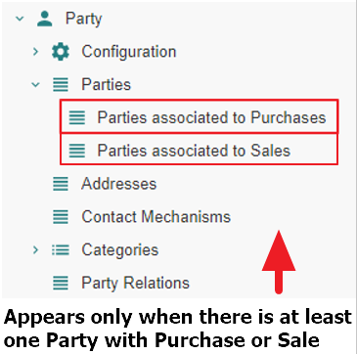
Motivation
Suppliers are named « Parties associated to Purchases ». We name them hereafter « Supplier » for commodity.
Suppliers are in fact party entity roles : any party promotes to a supplier as soon as one or more purchases are linked to it. Same for sales.
Creation : a supplier can be defined by creating an instance with the Menu Tree Item
« Parties » or
« Parties associated to Purchases » if it exists (see Access hereafter).
Access : as long as no purchase is linked to a party, it is not recognized as a supplier and will only be accessible using the Menu Tree Item « Parties ».
Note finally that « Party » modules have been activated as explained in the previous document « Basic Functionality ».

Slide 8
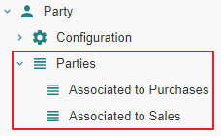
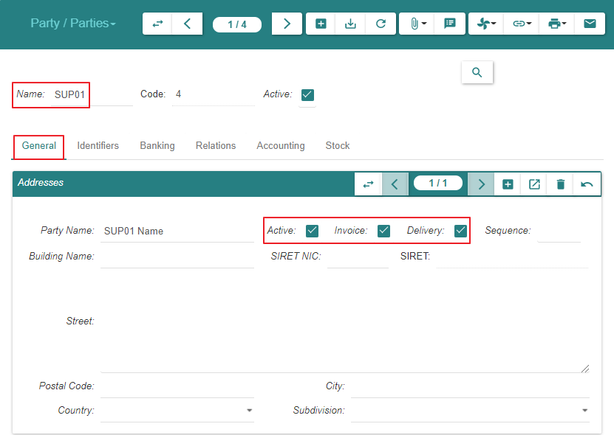
Create

Slide 9
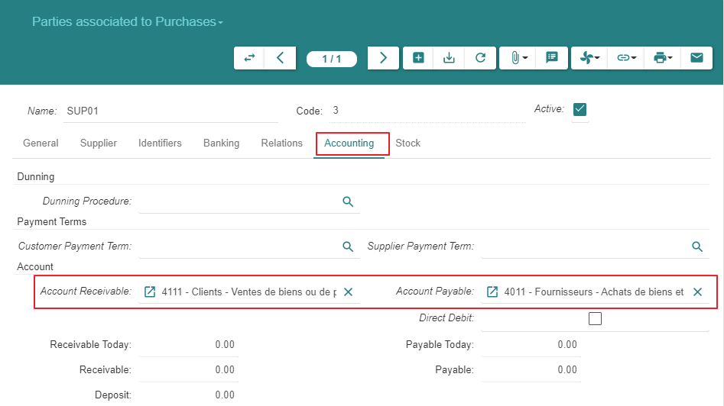
Create

Slide 10
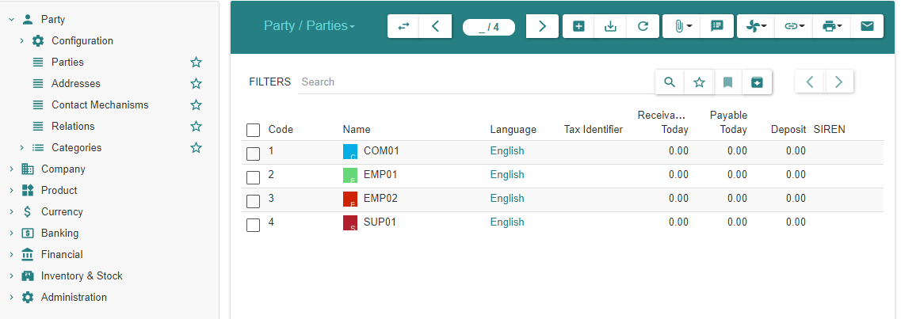
Summary
As explained under « Motivation », the supplier always appears in the list « Parties » above
As long as there are no purchases linked to the supplier, it is absent from « Parties associated to Purchases »
When at least one purchase exists, the supplier appears in both lists

Slide 11
Product

Slide 12
Module Activation

Slide 13
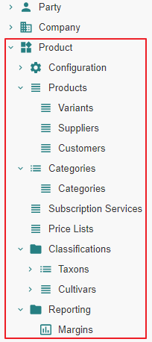
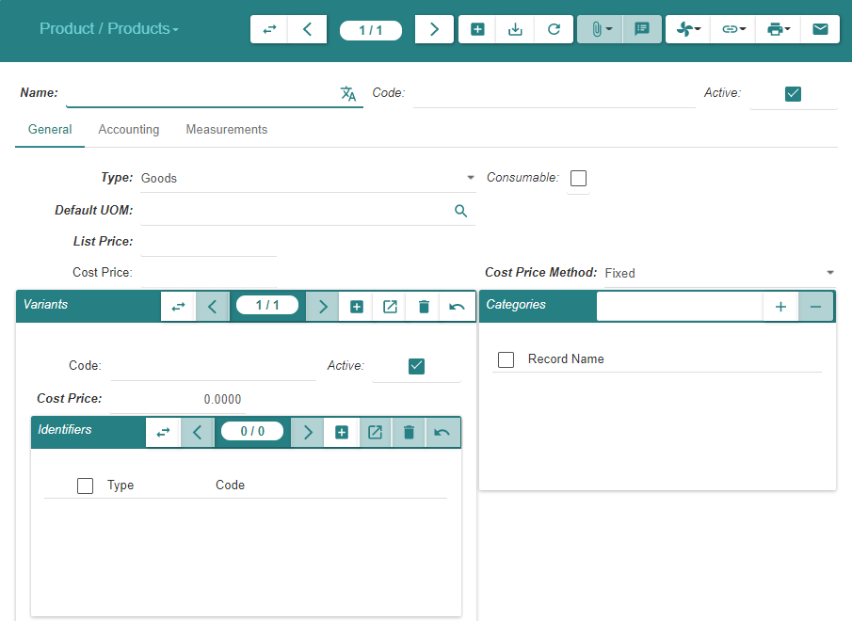
State « Ante »

Slide 14
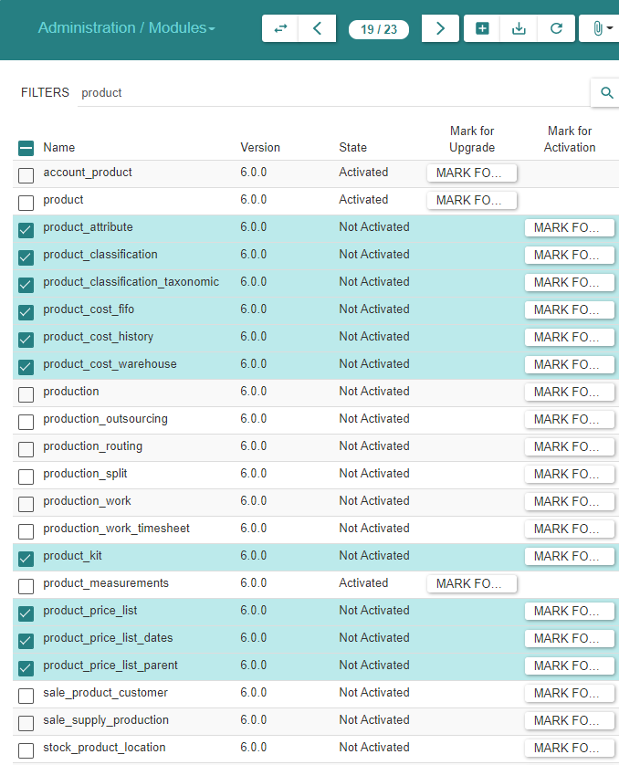
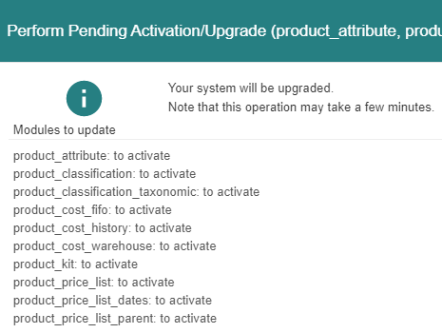
Module Activation

Slide 15
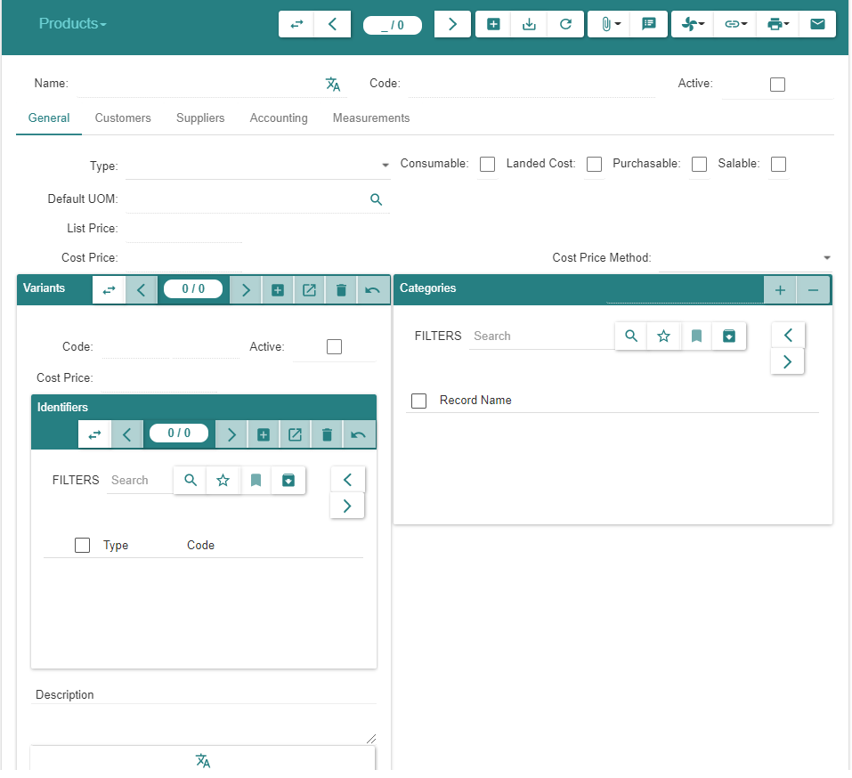
State « Post »

Slide 16
Product & Variant Creation

Slide 17
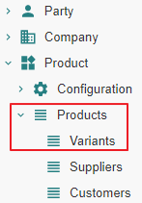
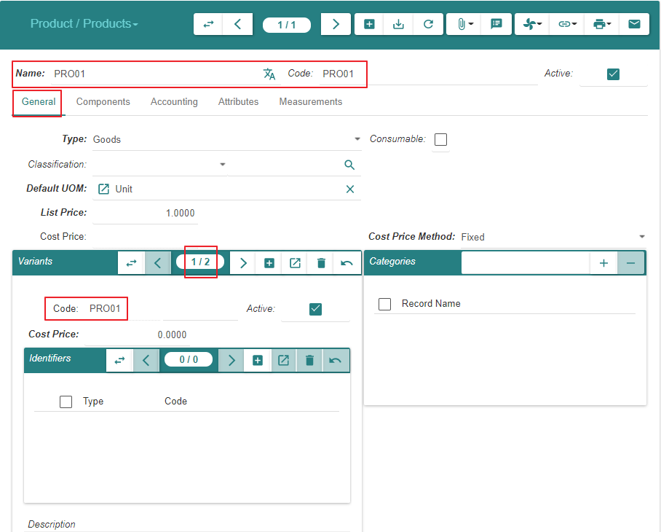
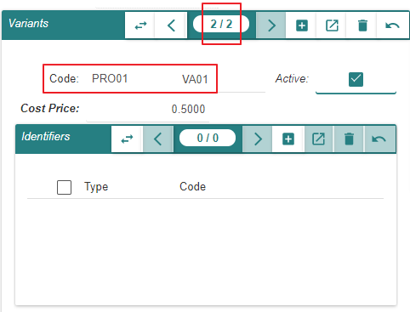
Create « Product PRO01 » & « Variant VA01 »

Slide 18
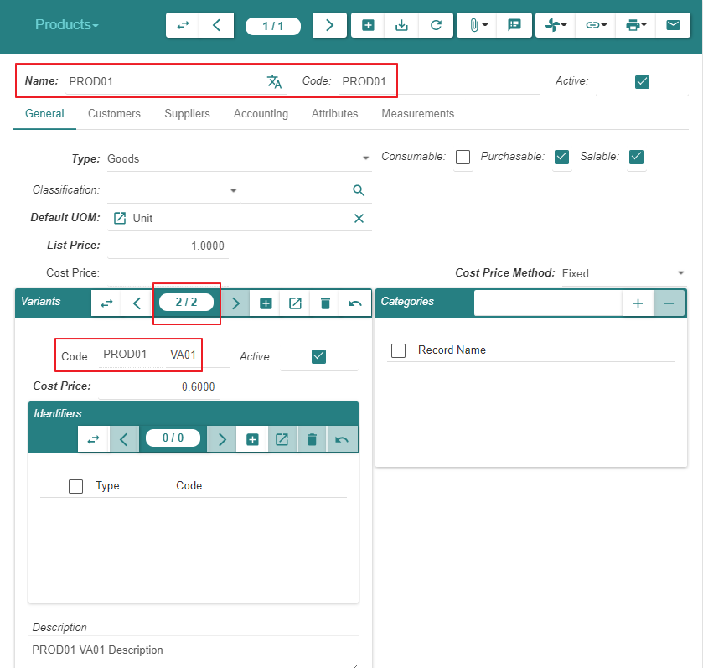
Create « Product PRO01 » & « Variant VA01 »

Slide 19
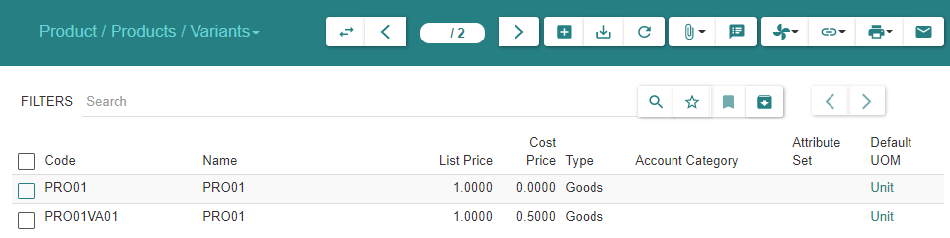
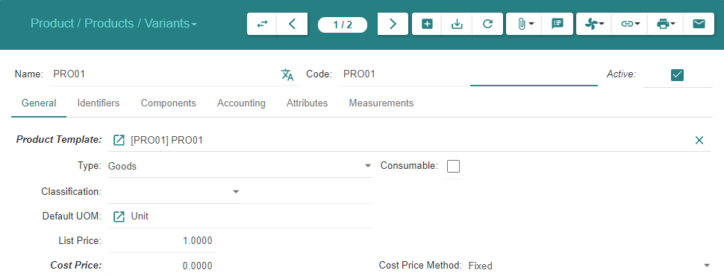
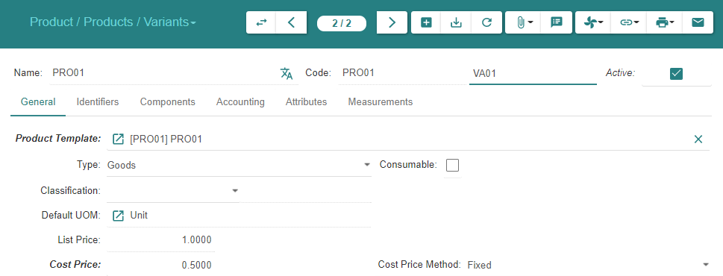
Display « Variants »

Slide 20
Inventory & Stock

Slide 21
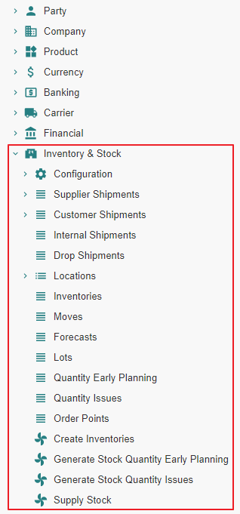
Motivation
We activate all inactive « Inventory & Stock » related modules

Slide 22
Module Activation

Slide 23
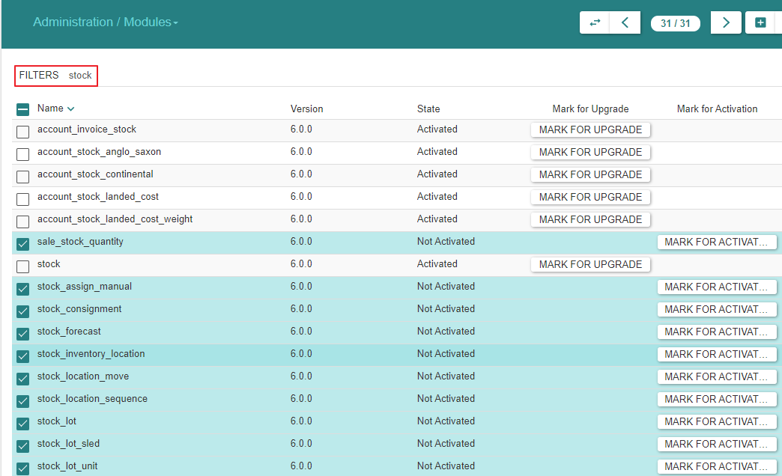
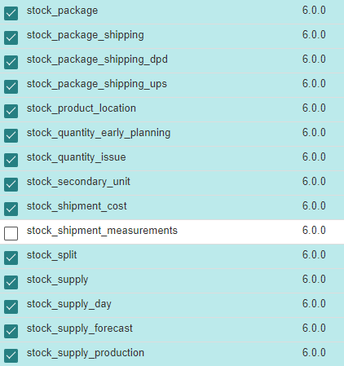
Module Activation

Slide 24
Purchase

Slide 25
Module Activation

Slide 26
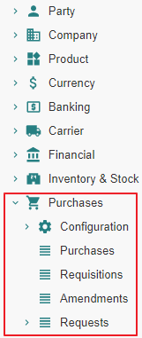
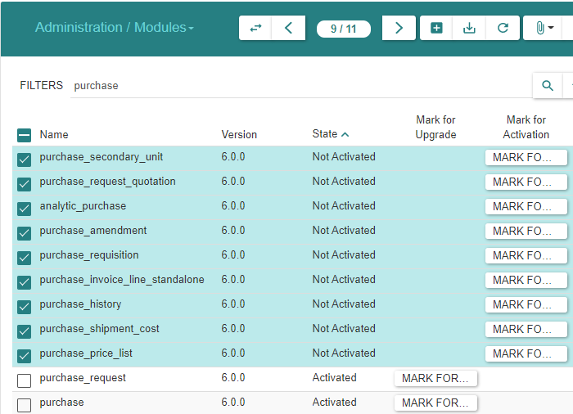
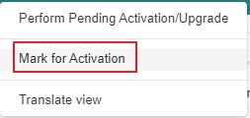
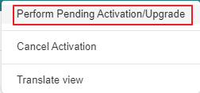
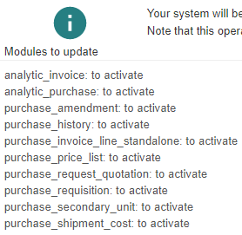
Module Activation

Slide 27
Purchase Configuration

Slide 28
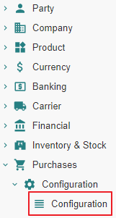
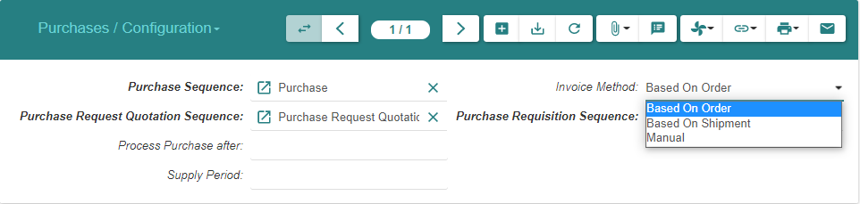
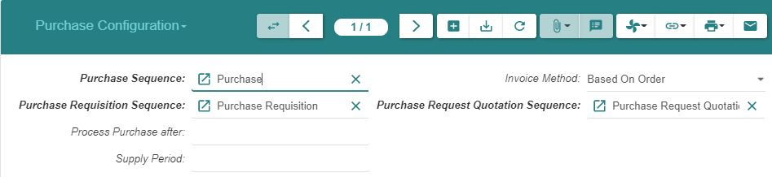
Purchase Configuration (1/2)
Note : The configuration for « Drop Shipment Sequence » will be available later once we activate the « Sale » modules

Slide 29
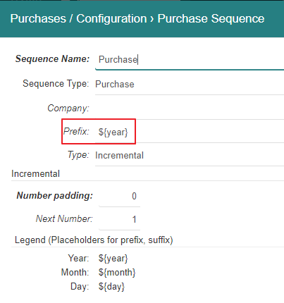
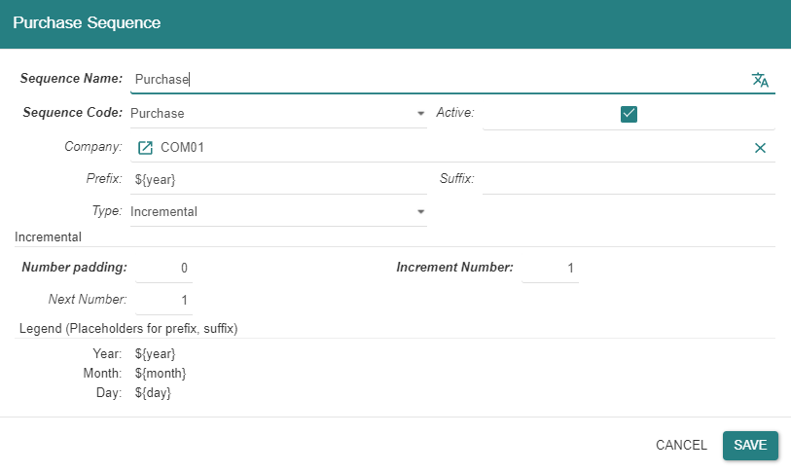
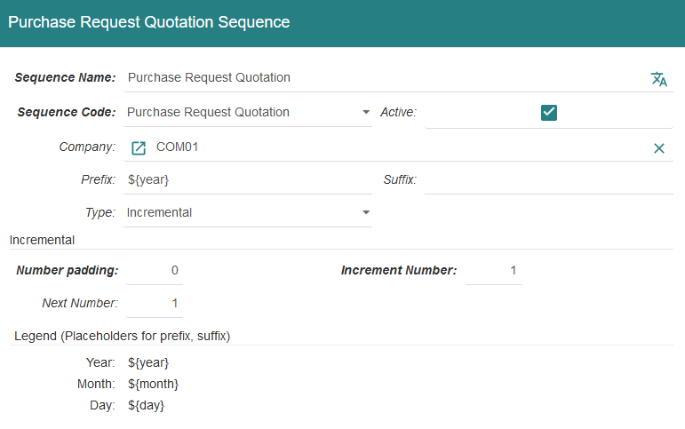
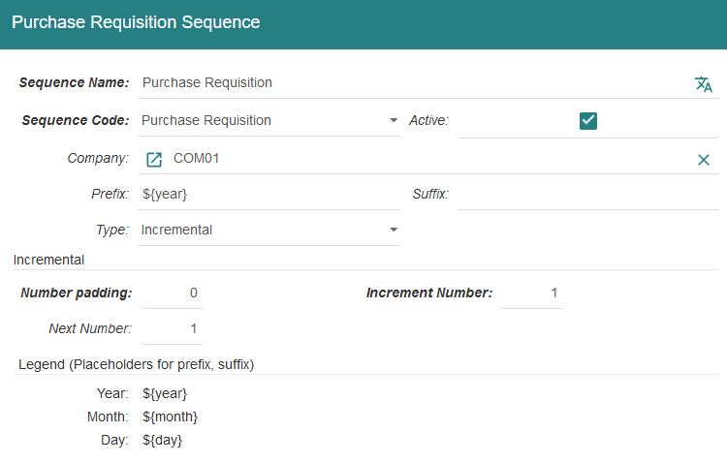
Purchase Configuration (2/2)

Slide 30
Product

Slide 31
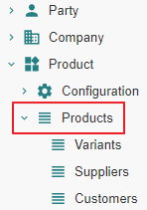
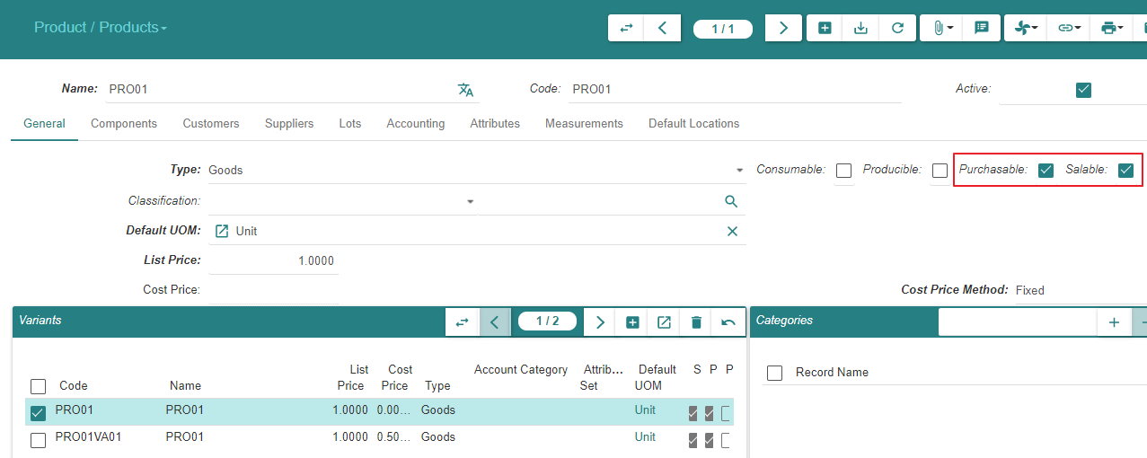
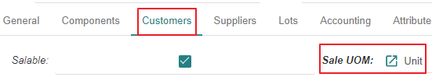
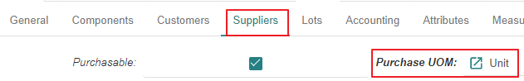
Motivation
We added the « Purchase » functionality to the system
We now declare the « Product » « Purchasable » & « Salable »

Slide 32
Purchase - Related Entities State Changes

Slide 33
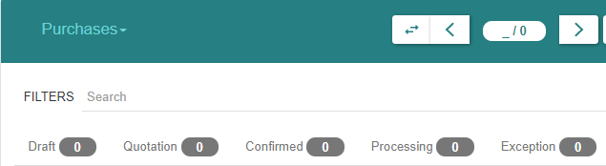
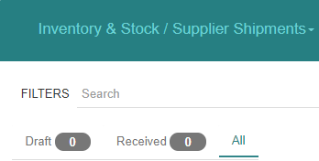
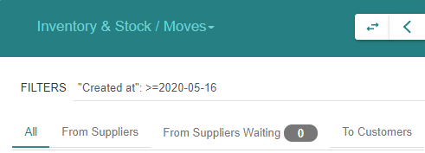
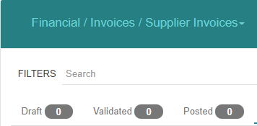
« Purchase » related states

Slide 34
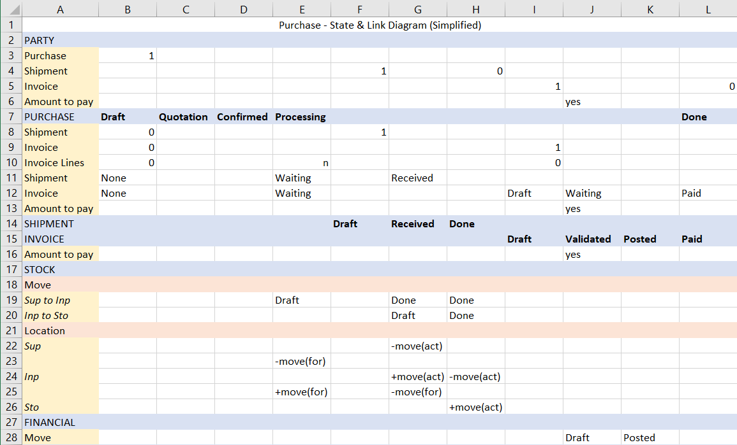

Slide 35
Impacted functions

Slide 36
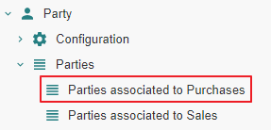
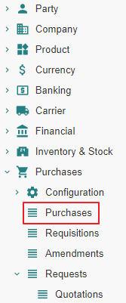
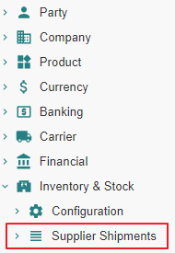
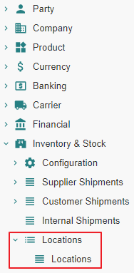
Impact analysis - list of functions

Slide 37
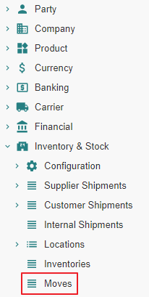
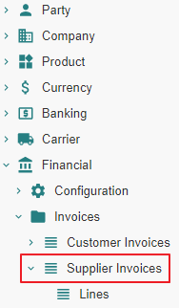
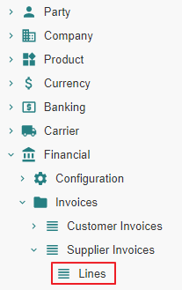
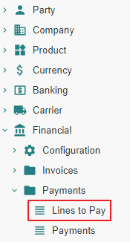
Impact analysis - list of functions

Slide 38




Impact analysis - list of functions

Slide 39




Impact analysis - list of functions

Slide 40
Supplier Purchase - State Changes - Impact Analysis

Slide 41
Purchase From State « Nill » to State « Draft »

Slide 42
Purchase From State « Nill » to State « Draft » Action

Slide 43




Purchase
Purchases are not numbered whilst they are in state « Draft »
Enter « Delivery Date » in order to track « Location Stock Forecast »

Slide 44
Purchase From State « Nill » to State « Draft » Impact

Slide 45


Slide 46



1 - Parties associated to Purchases

Slide 47


2 - Purchases | Purchases (SUP01)

Slide 48


10 - Journals - Periods

Slide 49

11 - Account Moves
An « Account Move Line » is created in « State-Draft ». It impacts the General Ledger, the Balance Sheet », the Income Statement, the (Specific, e.g. Expense) Journal, the General Journal.

Slide 50



12 - Open Journal
When an « Account Move Line » is created on a given « Journal » (e.g. « EXP »), it impacts the General Ledger, the Balance Sheet », the Income Statement, the (Specific, e.g. Expense) Journal, the General Journal.

Slide 51


13 - General Ledger

Slide 52

14 - Balance Sheet

Slide 53

15 - Income statement

Slide 54

16 - General Journal

Slide 55



16 - Statements

Slide 56
Purchase From State « Draft » to State « Quotation »

Slide 57
Purchase From State « Draft » to State « Quotation » Action

Slide 58


Purchase
Purchases are numbered when they reach state « Quotation »
Purchases can be returned to state « Draft », e.g. when the price has been renegociated with the « Supplier »

Slide 59
Purchase From State « Draft » to State « Quotation » Impact

Slide 60


Slide 61
1 - Parties associated to Purchases

Slide 62


2 - Purchases | Purchases (SUP01)

Slide 63
Purchase From State « Quotation » to State « Confirmed » or From State « Quotation » to State « Processing »

Slide 64
State transitions
Upon « Confirm » action by the user, a « Sale » or « Purchase » evolves from state « Quotation » to :
State « Confirmed » when a latent purchase processing error condition exists
State « Processing » when such error does not exist.
In the present scenario, the error condition consists in the « Product » not being linked to an « Account Category » and the state transition is from « Quotation » to « Confirmed »
Confirmed
Confirm
-
Purchase Processing related Error Condition Exists
Confirm
-
Purchase Processing related Error Condition Resolved
Confirm
-
Purchase Processing possible
Confirm
Quotation
Processing

Slide 65
Purchase From State « Quotation » to State «Confirmed »

Slide 66
Purchase From State « Quotation » to State «Confirmed » Action

Slide 67

Purchase

Slide 68
Purchase From State « Quotation » to State «Confirmed » Impact

Slide 69


Slide 70


2 - Purchases | Purchases (SUP01)

Slide 71
Purchase From State « Confirmed » to State «Processing » Action

Slide 72


Purchase
The button “Process” checks that the purchase order is in a correct state with respect to forthcoming shipment, invoicing and accounting treatment.
In our example, an “Account Category” is missing on the “Product PROD01”

Slide 73


Purchase

Slide 74

Purchase

Slide 75
Purchase From State « Confirmed » to State «Processing » Impact

Slide 76


Slide 77


2 - Purchases | Purchases (SUP01)

Slide 78



4 - Stock Locations

Slide 79


4 - Stock Locations

Slide 80



5 - Stock Moves
« From Suppliers Waiting » iff « Purchase Delivery Date » exists

Slide 81



7 - Invoice Lines

Slide 82
Supplier Shipment - State Changes - Actual States

Slide 83

Motivation
It is certainly possible to process the shipment(s) pertaining to a « Purchase » using the « Move » menu item.
However, it is recommended to proceed using the « Supplier Shipment » functionality which will manage the following stock moves in a coherent fashion :
« Incoming Moves » between the supplier location and the warehouse input location
« Storage Moves » between the warehouse input location and the warehouse storage location

Slide 84
Supplier Shipment « Nill » To « Draft »

Slide 85
Supplier Shipment From « Nill » To « Draft » Action

Slide 86

Supplier Shipments – Incoming Moves - Using « Added » or « Created »

Slide 87

Supplier Shipments – Incoming Moves - Using « Added »

Slide 88

Supplier Shipments – Incoming Moves - Using « Created » (1/2)

Slide 89


Supplier Shipments – Incoming Moves - Using « Created » (2/2)
Using « Created », it is possible to fine tune « Product », « Quantity », « Unit Price »

Slide 90

Supplier Shipments – Inventory Moves

Slide 91
Supplier Shipment From « Nill » To « Draft » Impact

Slide 92


Slide 93

1 Parties associated to Purchases

Slide 94


2 - Purchases | Purchases (SUP01)

Slide 95


3 - Supplier Shipments | Supplier Shipments (SUP01)

Slide 96
Supplier Shipment « Draft » To « Received »

Slide 97
Supplier Shipment From « Draft » To « Received » Action

Slide 98

Supplier Shipments - Incoming Moves

Slide 99

Supplier Shipments - Inventory Moves

Slide 100
Supplier Shipment From « Draft » To « Received » Impact

Slide 101


Slide 102


2 - Purchases | Purchases (SUP01)

Slide 103

3 - Supplier Shipments | Supplier Shipments (SUP01)

Slide 104

4 - Stock Locations
« Supplier Forecast Quantity » remains « -5 », should be « 0 »

Slide 105

4 - Stock Locations

Slide 106

5 - Stock Moves

Slide 107
Supplier Shipment From « Received » to « Done »

Slide 108
Supplier Shipment From « Received » To « Done » Action

Slide 109

Supplier Shipments

Slide 110

Supplier Shipments

Slide 111

Supplier Shipments

Slide 112
Supplier Shipment From « Received » To « Done » Impact

Slide 113


Slide 114

1 - Parties associated to Purchases

Slide 115


2 - Purchases | Purchases (SUP01)
Note : The « Shipment » information appears to be different depending on the linked-by entity :
From the viewpoint « Supplier », there is no « Shipment » linked-to anymore
From the viewpoint « Purchase » there is still a « Shipment » linked-to

Slide 116



3 - Supplier Shipments | Supplier Shipments (SUP01)

Slide 117

4 - Stock Locations

Slide 118

4 - Stock Locations

Slide 119


4 - Stock Locations

Slide 120

5 - Stock Moves

Slide 121
Supplier Invoice - State Changes - Actual States

Slide 122
Supplier Invoices From State « Nill » to State « Draft »

Slide 123
Supplier Invoices From State « Nill » to State « Draft » Action

Slide 124

Supplier Invoices (1/3)

Slide 125

Supplier Invoices (2/3)

Slide 126

Supplier Invoices (3/3)

Slide 127


Supplier Invoice Lines
« Supplier Invoice Lines » are referenced to help build the « Supplier Invoice »

Slide 128
Supplier Invoices From State « Nill » to State « Draft » Impact

Slide 129


Slide 130

1 - Parties associated to Purchases

Slide 131


2 - Purchases | Purchases (SUP01)

Slide 132
Supplier Invoices

Slide 133
Supplier Invoice Lines
« Supplier Invoice Lines » are referenced to help build the « Supplier Invoice »

Slide 134
Supplier Invoices From State « Draft » to State « Validated »

Slide 135
Supplier Invoices From State « Draft » to State « Validated » Action

Slide 136

Supplier Invoices (1/2)

Slide 137

Supplier Invoices (2/2)

Slide 138
Supplier Invoices From State « Draft » to State « Validated » Impact

Slide 139


Slide 140


1 - Parties associated to Purchases

Slide 141


2 - Purchases | Purchases (SUP01)

Slide 142


6 - Invoices | Invoices (SUP01) (1/2)

Slide 143

6 - Invoices | Invoices (SUP01) (2/2)

Slide 144

7 - Invoice Lines

Slide 145


10 - Journals - Periods

Slide 146

10 - Journals - Periods

Slide 147


11 - Account Moves

Slide 148


12 - Open Journal

Slide 149

13 - General Ledger

Slide 150

14 - Balance Sheet

Slide 151

14 - Balance Sheet

Slide 152

15 - Income statement

Slide 153

16 - General Journal

Slide 154
Supplier Invoices From State « Validated » to State « Posted »

Slide 155

Motivation
https://www.accountingtools.com/articles/what-is-posting-in-accounting.html

Slide 156
Supplier Invoices From State « Validated » to State « Posted » Action

Slide 157

Supplier Invoices (1/2)
Notice that the « Post » operation could have been performed on the « Account Move » screen

Slide 158

Supplier Invoices (2/2)

Slide 159
Supplier Invoices From State « Validated » to State « Posted » Impact

Slide 160


Slide 161


2 - Purchases | Purchases (SUP01)

Slide 162
6 - Invoices | Invoices (SUP01) (1/2)
Notice that the « Post » operation could have been performed on the « Account Move » screen

Slide 163
6 - Invoices | Invoices (SUP01) (2/2)

Slide 164


8 - Lines to Pay

Slide 165


10 - Journals - Periods

Slide 166


11 - Account Moves

Slide 167


12 - Open Journal

Slide 168
Supplier Payment - State Changes - Actual States

Slide 169
Payment

Slide 170
Payment Precondition

Slide 171




Invoice Payment Method

Slide 172
Payment Action

Slide 173


Supplier Invoice (1/2)

Slide 174

Supplier Invoice (2/2)

Slide 175
Payment Impact

Slide 176


Slide 177



1 - Parties associated to Purchases

Slide 178


2 - Purchases | Purchases (SUP01)

Slide 179
6 - Invoices | Invoices (SUP01) (1/2)

Slide 180
6 - Invoices | Invoices (SUP01) (2/2)

Slide 181


8 - Lines to Pay

Slide 182



10 - Journals - Periods

Slide 183


11 - Account Moves

Slide 184

11 - Account Moves

Slide 185


12 - Open Journal

Slide 186


12 - Open Journal

Slide 187

13 - General Ledger

Slide 188

14 - Balance Sheet

Slide 189

14 - Balance Sheet

Slide 190

16 - General Journal

Slide 191
16 - Statements

